Slide 1

Student name: Ramya K Enrollment No:EBEON1122698382
RESTAURANT
MANAGEMENT
SYSTEM
Trainer name:
Janani v

Slide 2
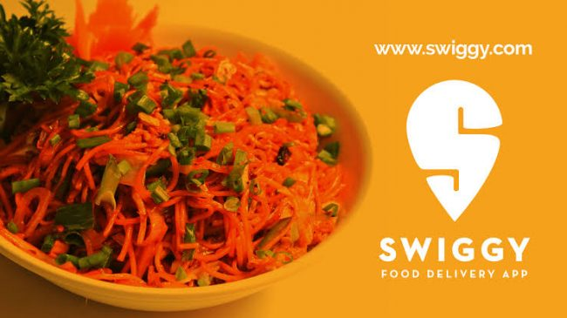
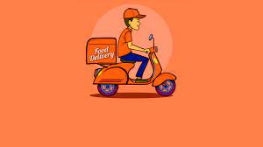
Overview:
we will learn about how to develop a full stack web application that is basic Swiggy restaurant management Application using Angular 10 and Spring Boot.
We developed some features:
Create Restaurant
List of Restaurant
Update restaurant details
Delete Restaurant details
View Restaurant details
Search restaurant using restaurant name.
Filter veg and nonveg restaurant list.

Slide 3
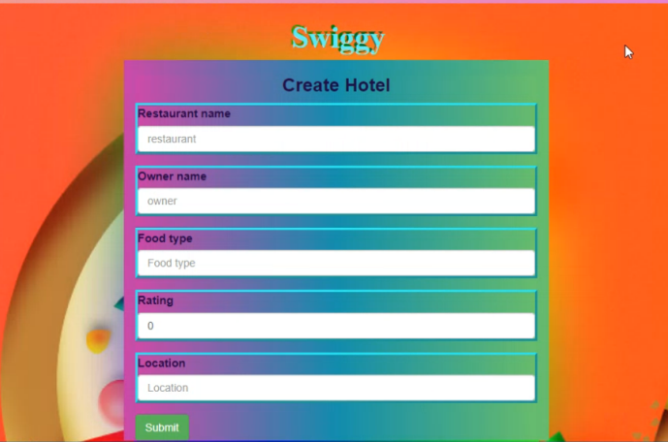
OUTPUT FOR REFERENCE:
Create Restaurant:

Slide 4
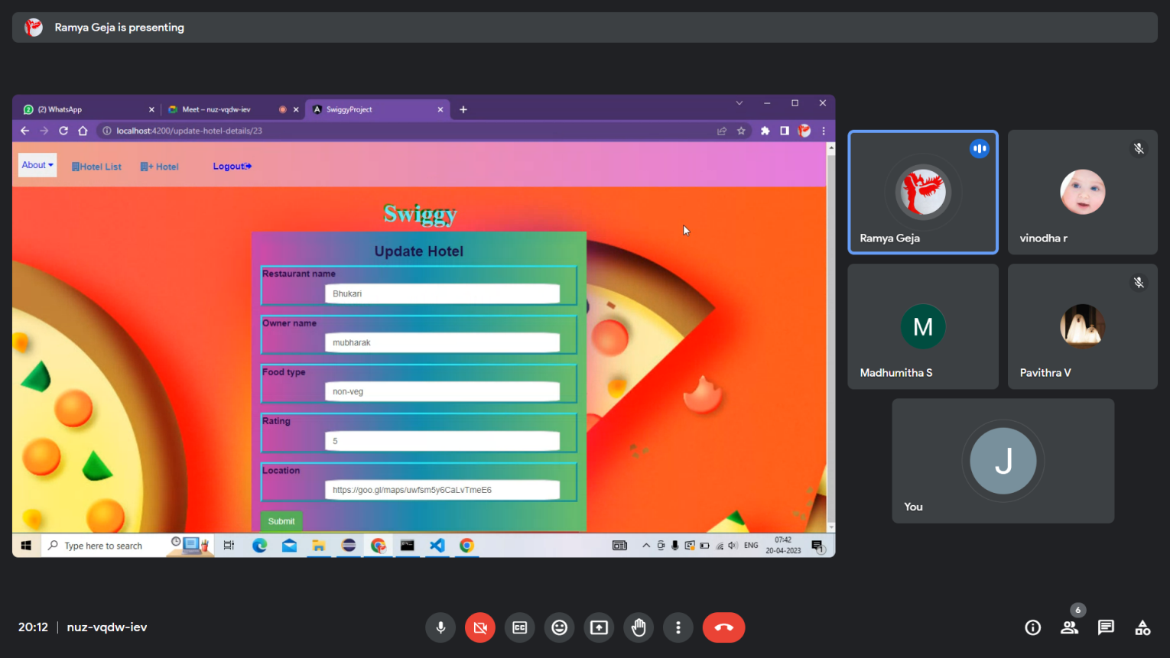
Update Restaurant:

Slide 5
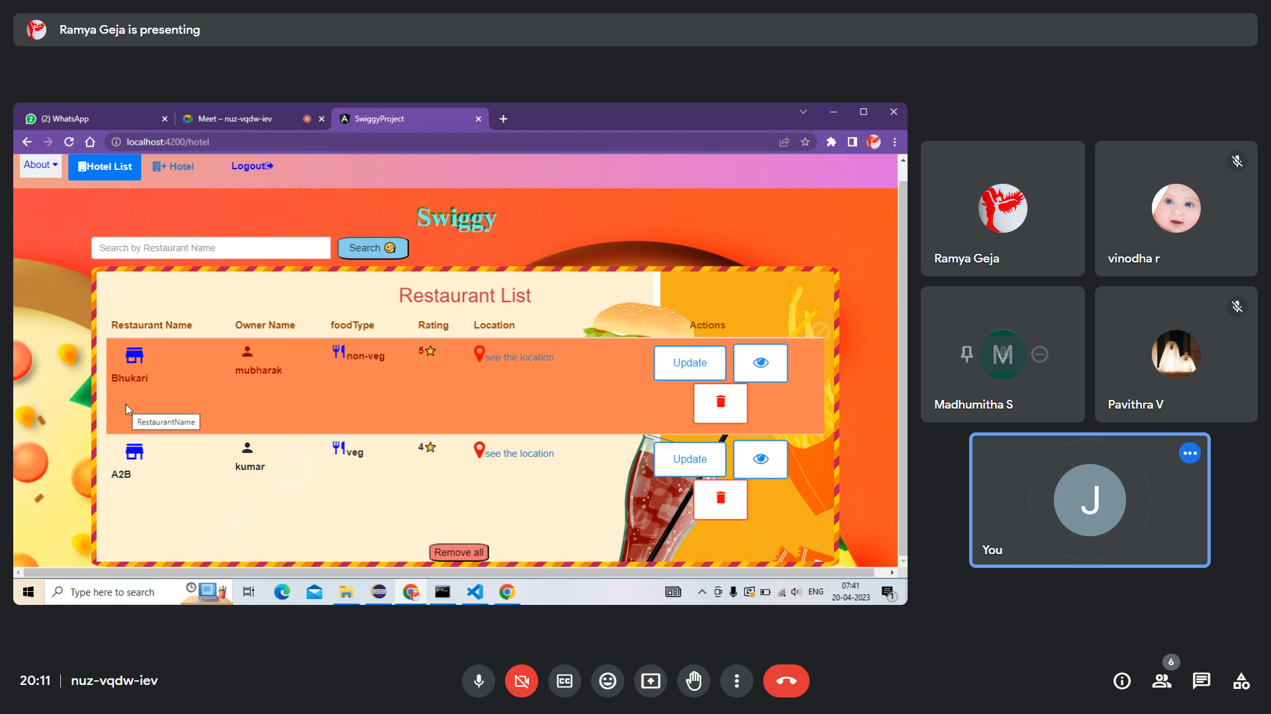
Restaurant List:

Slide 6
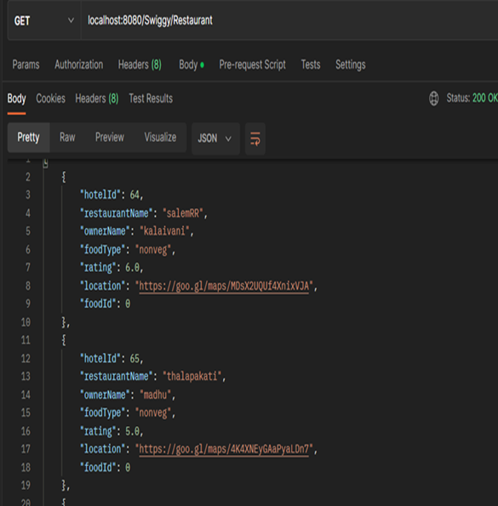
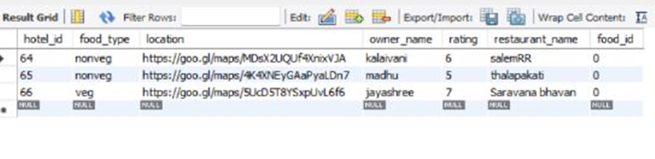

Slide 7
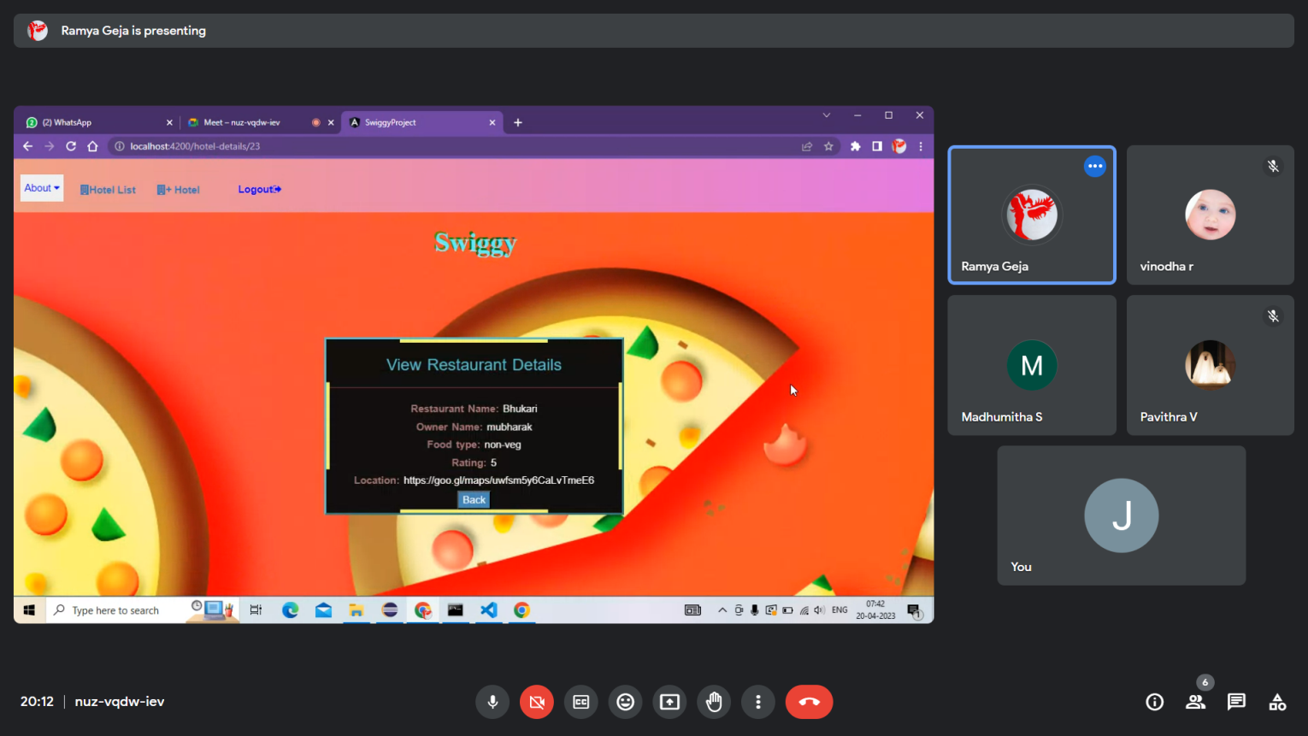
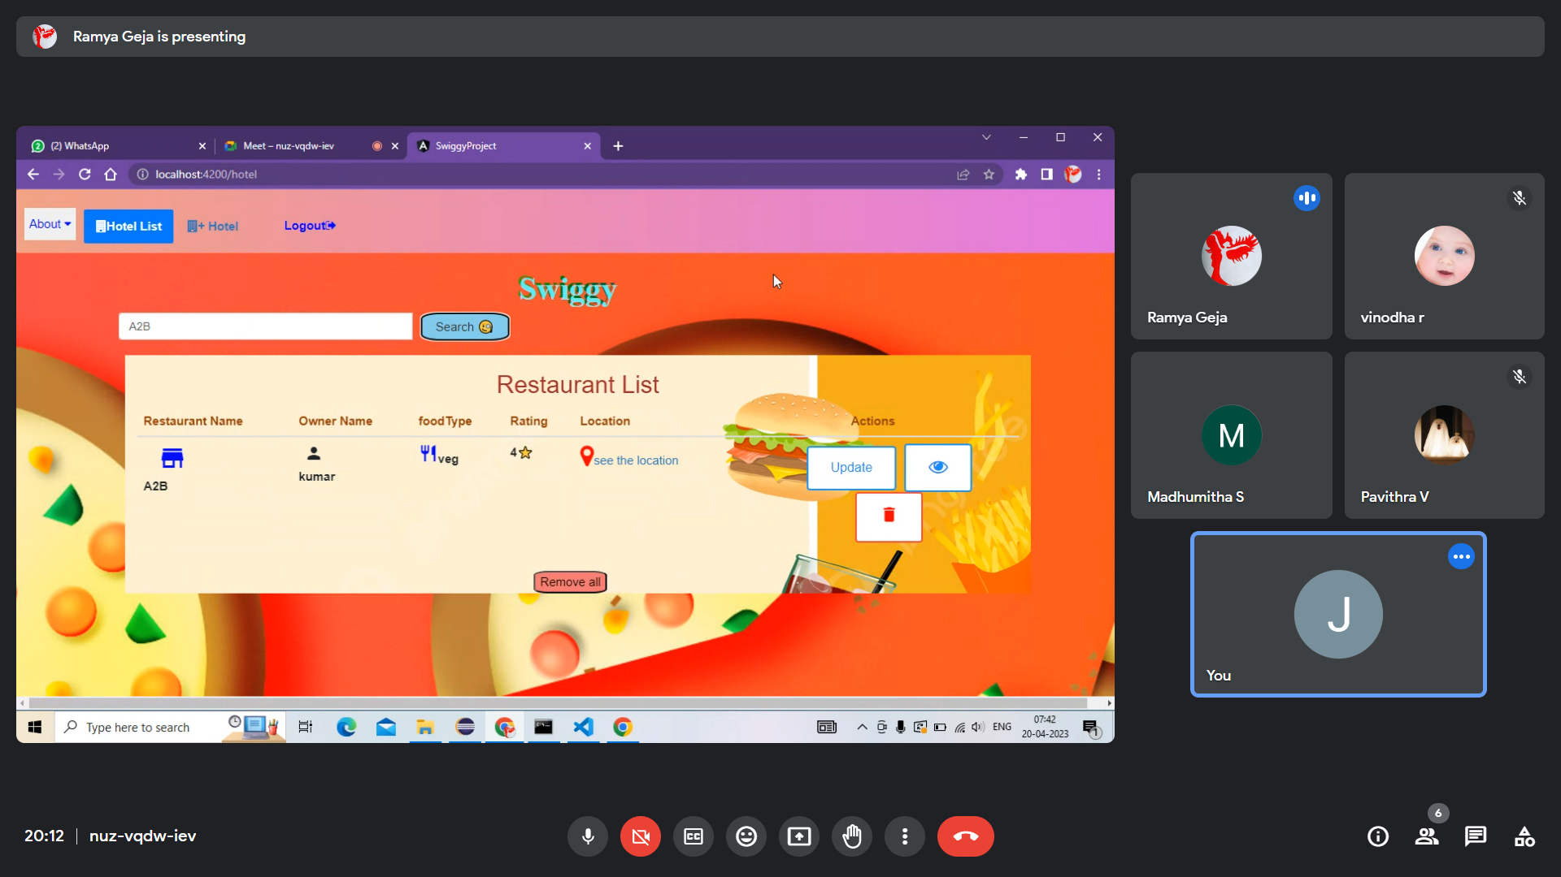
VIEW Restaurant:
Search Restaurant:

Slide 8

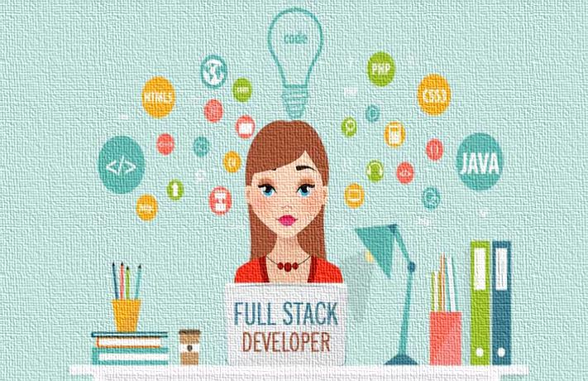
TECHNOLOGIES USED
TECHNOLOGIES USED
FRONT END
HTML
CSS
JAVASCRIPT
BOOTSTRAP CSS
ANGULAR
DATABASE
MYSQL
BACKEND
JAVA
HIBERNATE
SPRING
REST API

Slide 9
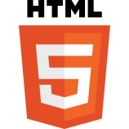
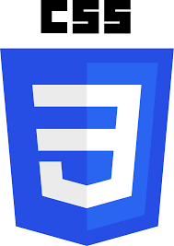
FRONTEND:
HTML :
HTML (Hyper text Markup Language) is the code that is used to structure a web page and its content.
For example, content could be structured within a set of paragraphs, a list of bulleted points, or using images and data tables.
CSS :
CSS (Cascading Style Sheets) is used to style and layout web pages
for example, to alter the font, color, size, and spacing of your content, split it into multiple columns, or add animations and other decorative features

Slide 10
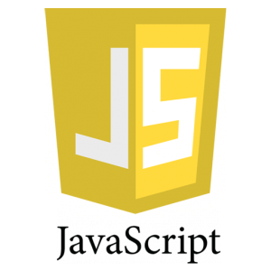
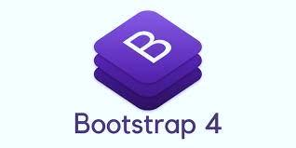
JAVASCRIPT:
JavaScript is a scripting language that enables you to create dynamically updating content, control multimedia, animate images, and pretty much everything else.3 days ago
BOOTSTRAP CSS:
Bootstrap is a free front-end framework for faster and easier web development. Bootstrap includes HTML and CSS based design templates for typography, forms, buttons, tables, navigation, modals, image carousels and many other, as well as optional JavaScript plugins

Slide 11
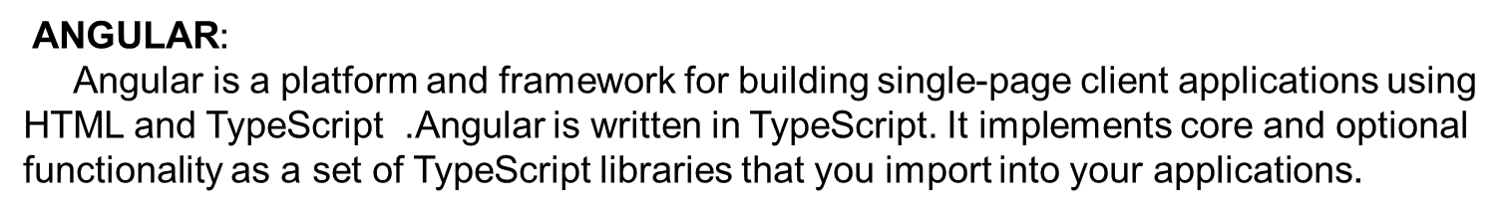
DATABASE
MYSQL :
MySQL is a relational database that uses structured query language. Relational databases are a type of database that uses a structure that allows us to identify and access the data in relation to another piece of data inside of the database. This format is often organized as tables

Slide 12
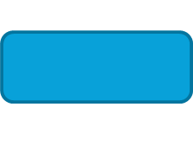
Backend:
HIBERNET:
Hibernate is an open source object relational mapping (ORM) tool that provides a
framework to map object-oriented domain models to relational databases for web applications.
Java Spring Framework (Spring Framework) is a popular, open source,
enterprise-level framework for creating standalone, production-grade applications that
run on the Java Virtual Machine (JVM).
SPRING:

Slide 13
REST API :
A RESTful API is an architectural style for an application program interface (API)
that uses HTTP requests to access and use data.
That data can be used to GET, PUT, POST and DELETE data types, which refers to
the reading, updating, creating and deleting of operations concerning resources
JAVA:
Java is a high-level, class-based, object-oriented programming language that is designed to have as few implementation dependencies as possible. It is a general-purpose programming language intended to let programmers write once, run anywhere (WORA)

Slide 14
ARCHITECTURE DIAGRAM
FRONTEND
BACKEND
Cross origin
Angular
Spring boot
FR
HTTP
Spring
restController
Spring data JPA
DB
mysql
Router
Component
service
Model

Slide 15
Backend Flow (Spring boot):
What happened when the spring boot application run? ….
If you click run spring boot application . The main application context is kicked off which in turn searches for the classes annotated with @Configuration, initializes all the declared beans in those configuration classes, and based upon the scope of those beans, stores those beans in JVM, specifically in a space inside JVM which is known as IOC container. After the creation of all the beans, automatically configures the dispatcher servlet and registers the default handler mappings, message Converts, and all other basic things.
spring boot supports three embedded servers:-
Tomcat (default), Jetty and Undertow.

Slide 16
Explanation:
The Client makes an HTTP request(GET, PUT, POST, etc.)
The HTTP request is forwarded to the Controller. The controller maps the request. It processes the handles and calls the server logic.
The business logic is performed in the Service layer. The spring boot performs all the logic over the data of the database which is mapped to the spring boot model class through Java Persistence Library(JPA).
The JSP page is returned as Response from the controller.

Slide 17
Frontend flow(Angular):-
Tool used:
Using Angular we have done Frontend.
Explanation:
Before Starting the Angular server we have to run Spring Boot Application.
We use auth guard services,session storage for login to store username,app routing to give path for all the subcomponents.
When the server is Started in Angular first it comes into index.html. In index.html there is an App root it went to app module and
app Component . ts(app .component . html , app .component .css) and then it goes to app.routing.module.ts(path is given for all the sub components).
After that we have to create Subcomponent like create.update,list,view,login,logout,feedback,homepage,etc….
By Using these subcomponent there is service class in that we have to give base Url to connect backend Using @crossorgin annotation in service class.

Slide 18

THANK YOU…….

